Slide 1

Introduction To Operating System
Presenter: Piyush

Slide 2
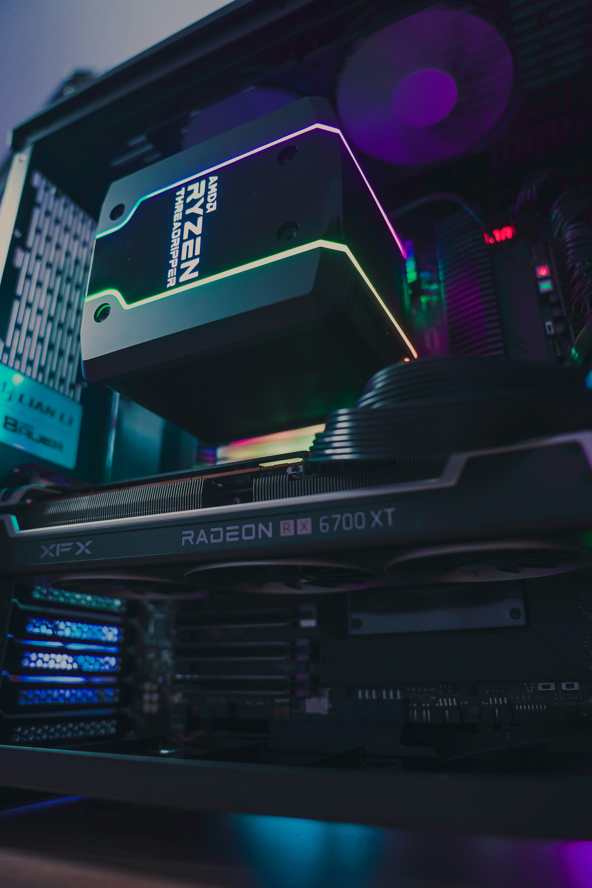
Comprehensive Overview of Operating Systems
Exploring the Essential Functions of OS
Definition of Operating System
An OS is software managing hardware and software resources, providing common services.
Resource Management
OS allocates and manages memory and processing power for efficient operations.
User Interface
It provides user-friendly interfaces, like command-line and graphical.user interfaces.
File Management
OS organizes and accesses files, ensuring efficient data handling on devices.
Security and Access Control
OS protects data from unauthorized access, ensuring user security and privacy.
Importance of OS
OS is essential for running computers, smartphones, and other digital devices.
Foundation for Advanced Concepts
Understanding OS basics prepares users for complex operating system topics.

Slide 3
Understanding
Operating System Types
Explore the different categories of operating systems

